Slide 1







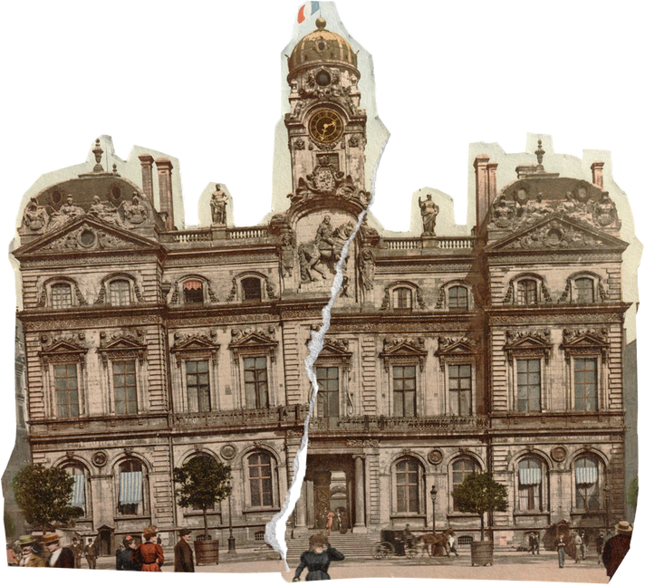

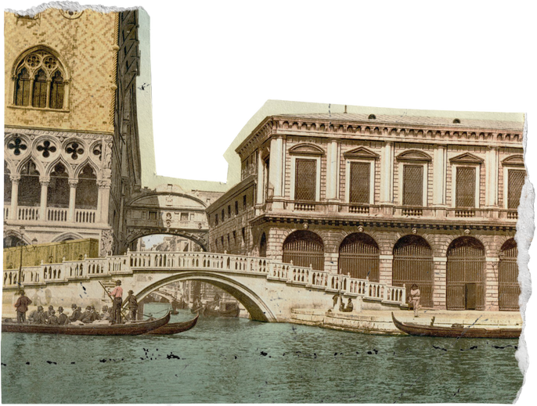
Roamantics: Your Travel Planner
Prepared By :-
Shah Meet Arpitkumar
Mistry Kahan Hiren
Shah Rochan Vimalbhai
Bhatt Vatsal Rakesh
Shah Viraj Manoj

Slide 2




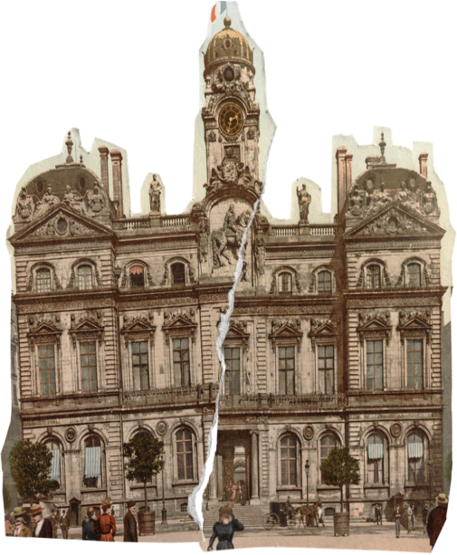
Introduction
Roamantics is a travel planning website designed to simplify the way users search for hotels, destinations, and flights with exciting offers.
It provides a seamless experience for travelers by offering curated travel content, trending destinations, and hotel recommendations.
Built with HTML, CSS, Bootstrap and JavaScript for an engaging, responsive and functioning design.

Slide 3

Technologies Used
HTML (HyperText Markup Language): Used for structuring the web pages and content.
01
02
CSS (Cascading Style Sheets): Applied for styling, layout design, and visual appeal.
Bootstrap: A responsive framework that provides pre-built components, making
the design mobile-friendly and modern.
03
04
JavaScript: Applied for better function of the website.

Slide 4




Functionalities
Navigation Bar: Allows users to easily switch between different pages.
Search Functionality: Users can search for offers or packages from the homepage.
Cards & Grid Layout: Used for displaying hotel listings, destinations, offers and blogs in an organized manner.
Responsive Design: Ensures the website adapts to different screen sizes, making it accessible on mobile, tablets, and desktops.
Image Sliders & Carousels: To showcase trending destinations and featured content dynamically.
Forms & Buttons: Interactive elements for user engagement, such as search bars and call-to-action buttons.

Slide 5



Advantages
Disadvantages
Simple and intuitive design for easy navigation.
Works seamlessly on mobile, tablet, and desktop devices.
Users can explore hotels, destinations, offers and travel blogs in one place.
Since it's built using HTML, CSS, Bootstrap and JavaScript, it loads quickly.
Information is not dynamically updated, meaning hotels and place listings and blog content need manual updates.
Users cannot create accounts or save preferences.
No personalized recommendations based on user preferences.
Basically, it is a static website.

Slide 6
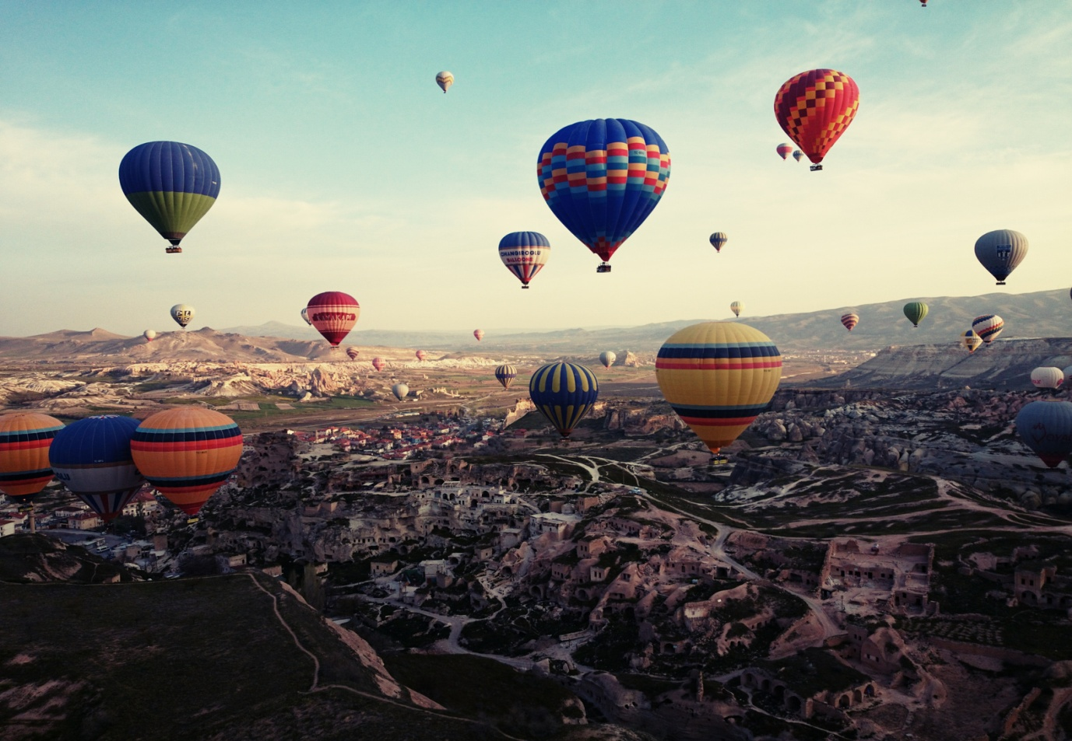

Future Scope
Implement database (Firebase, or MongoDB) to store user data, hotel details, and travel logs.
Integrate travel APIs (e.g., Google Flights, Skyscanner, Booking.com) for live availability and pricing.
Add login/signup page to store user login credentials and user data.
Use AI to analyze user preferences and suggest personalized destinations and implement chatbots for travel guidance and customer support..

Slide 7
Thank You!

